Slide 1
CS 373 Final Project
By, Joshua Minutello, Mark McMahon, and Jason Scott

Slide 2
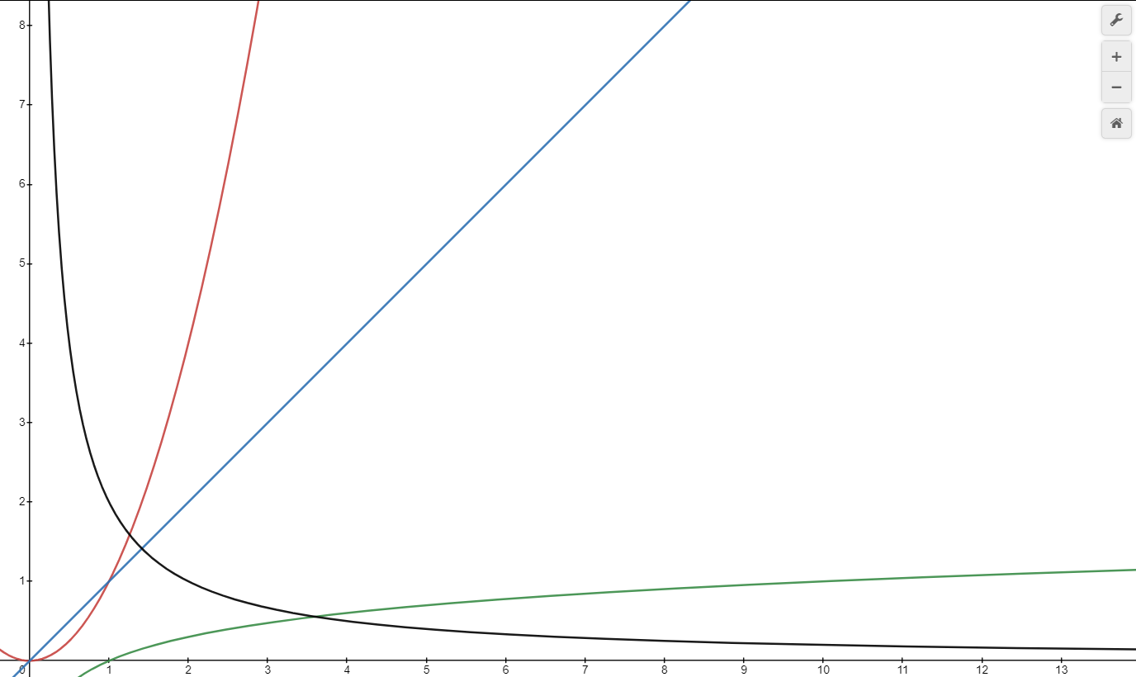
Problem Statement
Find a meaningful algorithm with a decreasing runtime complexity
Possible Upper Bound associated with O(1/n)
Find an algorithm which runs faster as the input size increases
Counterintuitive to most algorithms
Is an algorithm with decreasing runtime complexity realistic?
Feasibility of an algorithm with O(1/n) time complexity
Algorithm performance against alternative solutions
Possible drawbacks with a O(1/n) runtime
Problem: Finding a specific word or phrase in a given text

Slide 3
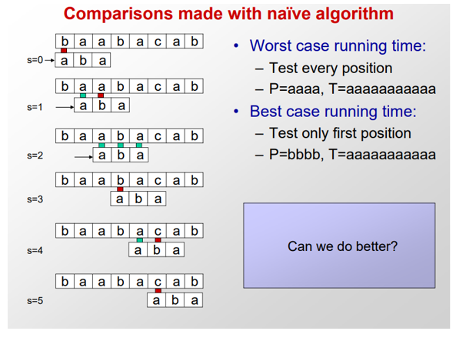
Boyer-Moore Algorithm Purpose
Given input string ‘x’ and text ‘y’, search through the given text and determine if ‘x’ is a substring of ‘y’
Improve brute force string searching algorithm
The brute force algorithm must go through every letter in the string we are trying to match against
The Boyer- Moore algorithm excels when the input string is larger
The input string is the string that we are searching for within another given string
As the the input string size gets bigger the algorithm gets more efficient
This has many practical applications in software

Slide 4
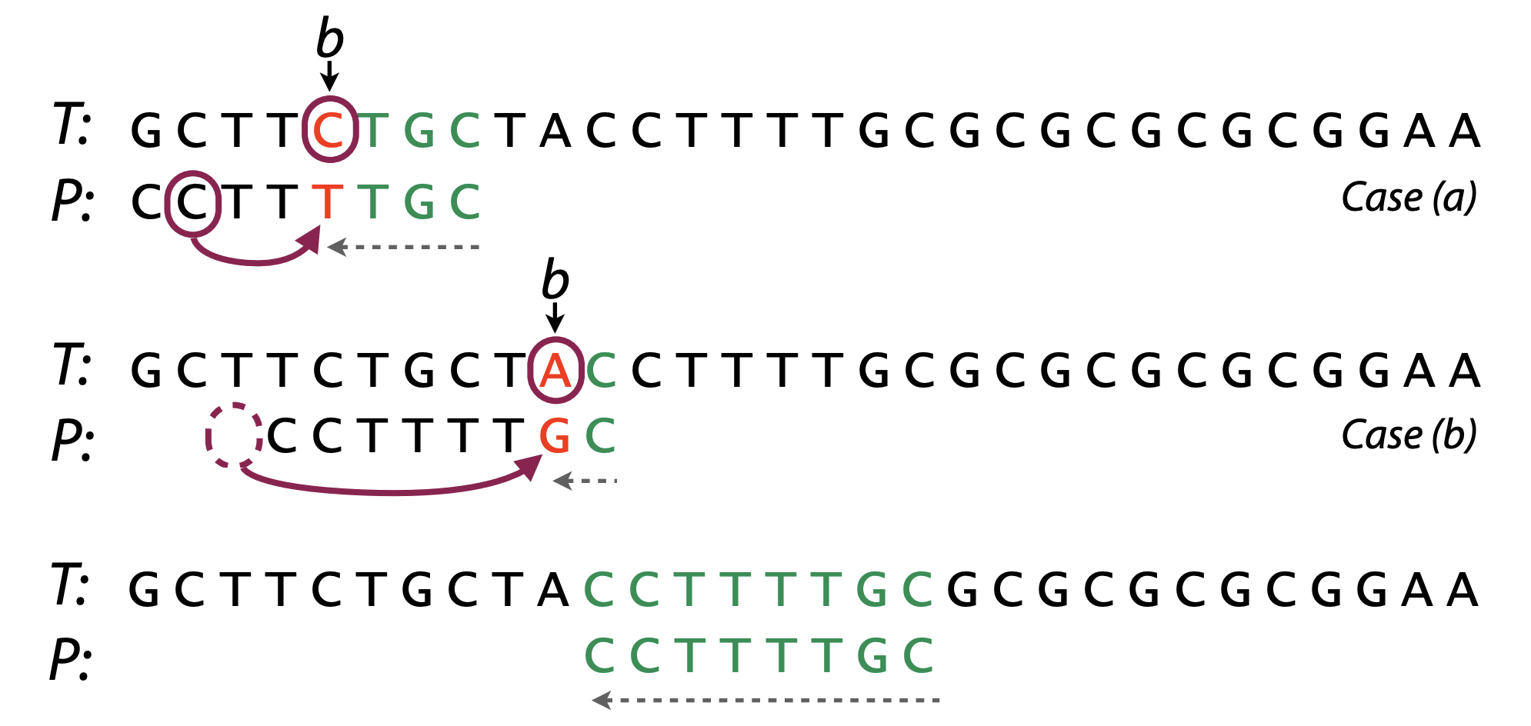
Boyer-Moore Algorithm
Instead of comparing every single letter, the Boyer-Moore algorithm uses knowledge gained from comparisons to skip future comparisons. We are able to do this because of Bad Character Rule and the Good Suffix Rule
Bad Character Rule:
Start comparing from the tail of our input string (right to left).
Find the first character that does not align
Shift input string until a character matches the mismatches letter
If that is not a match, shift the input string to one after the mismatch letter

Slide 5
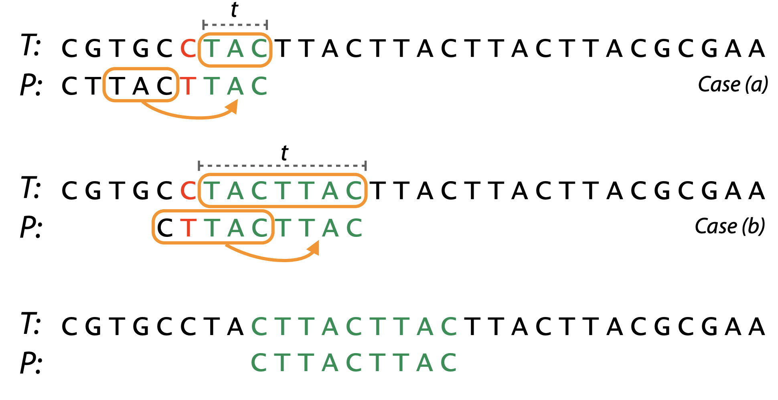
The Algorithm pt. 2
The Good Suffix Rule:
Start comparing from the tail of input string
Good Suffix is the characters which match the text
If we have a second set of characters in our input which matches the Good Suffix rule, align those characters with the Good Suffix
If only we have only a portion of the Good Suffix, we can also align the two partial good suffixes

Slide 6
The Algorithm pt. 3
boyerMooreStringSearch(inputTextFile, inputKey)
M = inputKey.size()
N = inputTextFile.size()
while(keyIndex <= n -m)
keyIndex = m - 1
While keyIndex > 0 and inputKey[keyIndex] == inputTextFile[keyShift +keyIndex] // while the characters
keyIndex - - //match, decrement keyIndex
If keyIndex <0
If keyShift + m < n
keyShift += m - badCharacterArray[inputTextFile[keyShift + m]])
Else
keyShift ++
Else
If 1 >= keyIndex - badCharacterArray[InputTextFile[keyShift + keyIndex]])
Keyshift++
Else
Keyshift += keyIndex - badCharacterArray[InputTextFile[keyShift + keyIndex]]

Slide 7
Algorithm Analysis
The most interesting feature of the algorithm is correlation between run-time and input size. Traditionally, when we think larger input size, we think greater run-time. However, with the bad character and good suffix rule, we see that input size and run-time have an inverse relationship.
Time Complexity
m is the size of the input string
n is the size of the text
Best Case: O(n/m)
Average Case: O(n)
Worst Case: O(m * n)

Slide 8
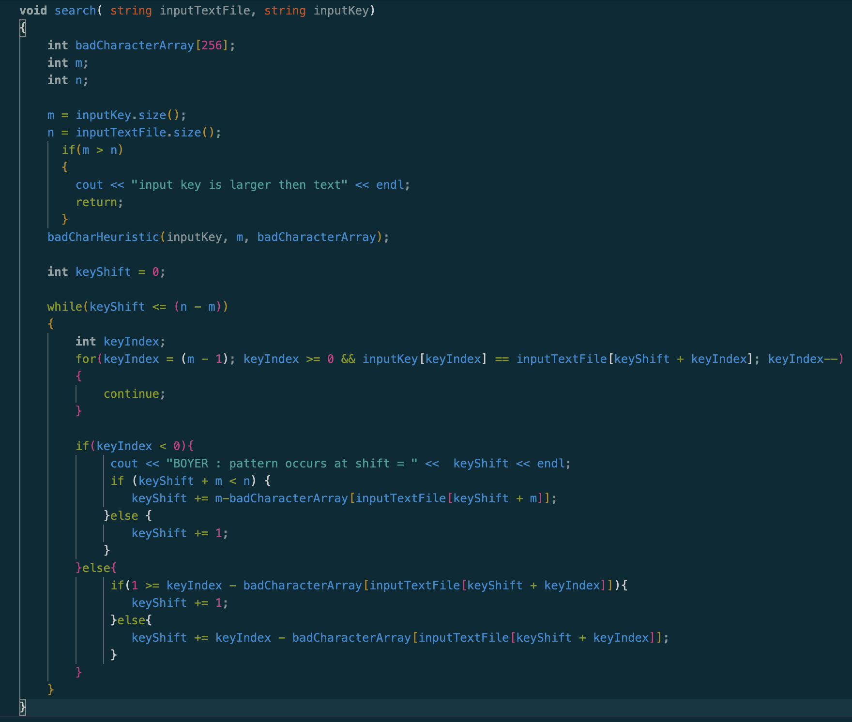
Implementation
We created this implementation of the Boyer-Moore String Search using C++
The only data structure we used was arrays
We used these arrays to keep track of which characters match
An array for the key for Boyer-Moore must be made
This makes Boyer-Moore need to have a larger start up cost, which Brute force does not need

Slide 9
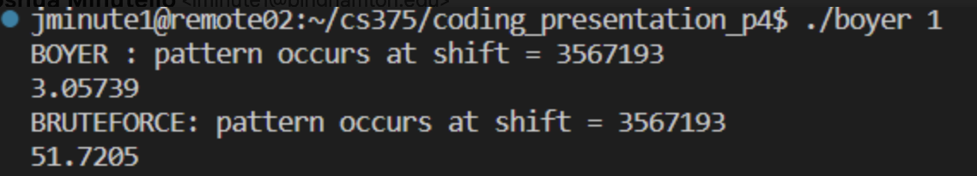
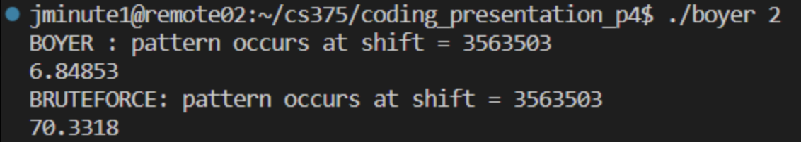
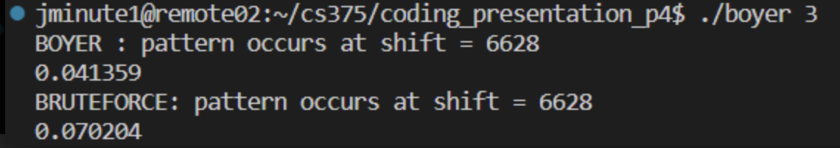
Demo
The first test case uses a large key and parses through a large text file
Here, Boyer-Moore is able to do many skips through the text file due to the large key size, creating the large disparity between the runtimes of both algorithms
The second test case uses a small key and parses through the same large text
Now we see the runtime of Boyer-Moore goes from 3 milliseconds to ~7 milliseconds
This is due to the smaller key size, creating less opportunities for skips to occur
The third test case shows the result of the small text file and small key, where the difference between the two algorithms is less than a tenth of a millisecond
With a larger key, brute force would actually be faster due to start up time needed
Im submitting my personal now cool : ) have good luck at poker : )

Slide 10
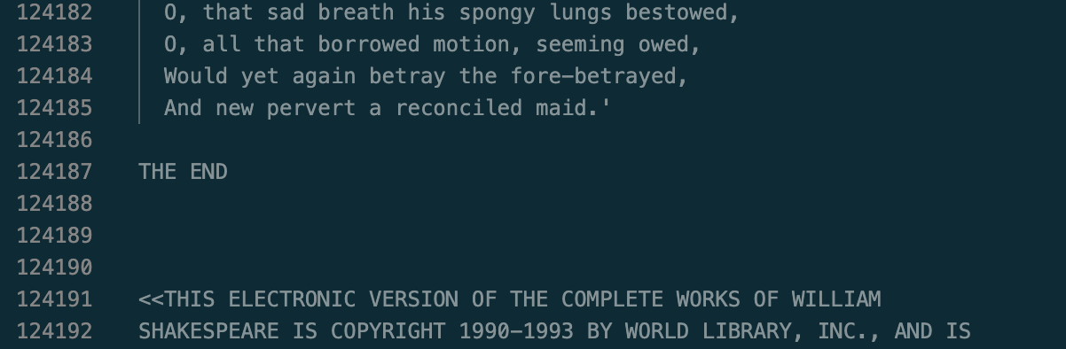
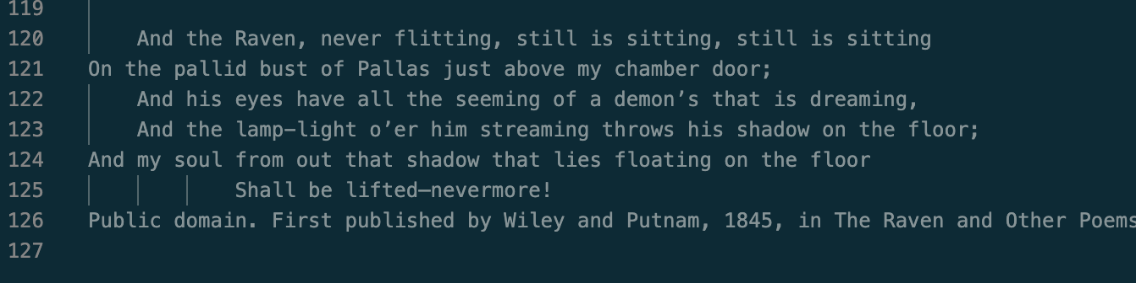
Experimental Plan
Our large dataset was the entire works of Shakespeare [124,192 lines]
Our short dataset was the poem the Raven [126 lines]
The goal of the short dataset was to show how for a small dataset, the time it takes for Boyer-Moore would be similar or worse than Brute Force
The goal of the large dataset was to demonstrate the benefit of Boyer-Moore, where more skips are able to occur, making it significantly faster than the Brute force algorithm

Slide 11
Results
Boyer-Moore string search algorithm runs faster than brute force for longer input strings
Effective and consistent search algorithm
Algorithm used for ctrl + f function
Start-up cost for Boyer-Moore algorithm sometimes makes it slower than Brute force for smaller text and input sizes
Time Complexity:
Best Case: O(m/ n)
Average Case: O(n)
Worst case: O(m*n)
Increasing the input string length skips multiple comparisons using Bad Character and Good Suffix Rule

Slide 12
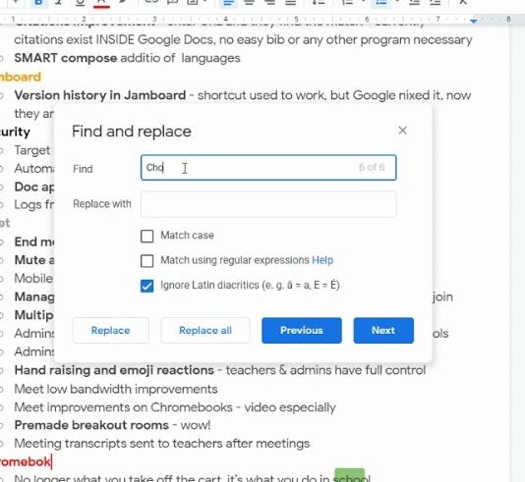
Limitations and Future Work
Limited by the size of the input string and the size of the text file
Add larger tests such as full dictionaries and search for specific words
Compare our results with a word/google docs search function for specific words and run time
Improve comparison time by implementing a hash table to identify each unique type of character
There are only so many characters anyway
Compare to Knuth Morris Pratt string search algorithm

Slide 13
Conclusion
Boyer-Moore algorithm is efficient for finding a string in a text
Outperforms bruteforce on most sets of texts and inputs
Even when brute force method outperforms Boyer-Moore algorithm, it is for marginally small runtimes
Start-up cost of implementing an array to do bad character and good suffix rule is more efficient than brute force overall
Boyer-Moore Algorithm ∈ O(1/n) in the best case situation while achieving a linear average runtime and a worst case situation that is infrequent

